Slide 1
Migraine Classification

Slide 2
Agenda
Problem
Defining the data set columns
Techniques applied

Slide 3
Problem
I have taken the data set of the Migraine Classification from the website Kaggle.
The data has 400 entries and 23 columns
The Columns are:
Age, Duration, Frequency, Location, Character, Intensity, Nausea, Vomit, Phonophobia, Photophobia, Visual, Sensory, Dysphasia, Dysarthria, Vertigo, Tinnitus, Hypoacusis, Diplopia, Defect, Ataxia, Conscience, Paresthesia, DPF
The data type of all the entries is integers, float.

Slide 4
Techniques applied
Data Preprocessing
Data cleaning
Dealing with missing values/outliers
Data Visualization
matplotlib
Exploratory Data Analysis (EDA)
Seaborn
Looking For Correlations
Train-Test Splitting
Random Forest Regressor
Random Forest Classifier

Slide 5
Have A Look To The Data Set Of Migraine
migraine.head()
migraine.head(10)
5

Slide 6
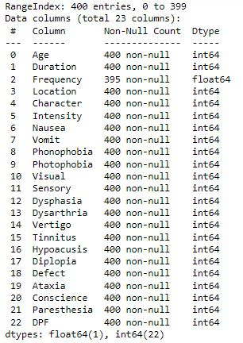


Data-cleaning steps
DATA SET INFO.

Slide 7
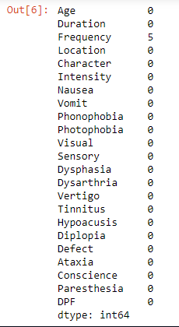
Data-cleaning steps
Checking for null values

Slide 8
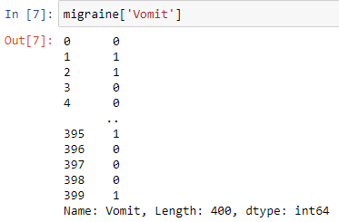
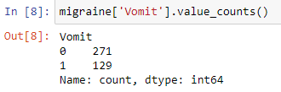
Data-cleaning steps
Particular Column Informations

Slide 9
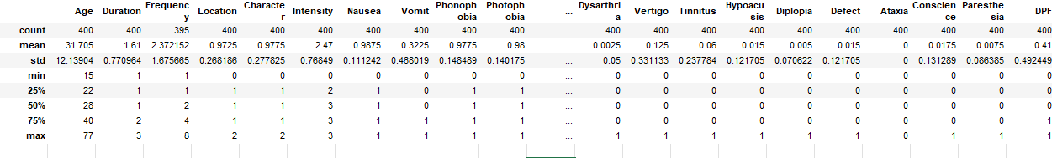
Data-cleaning steps

Slide 10
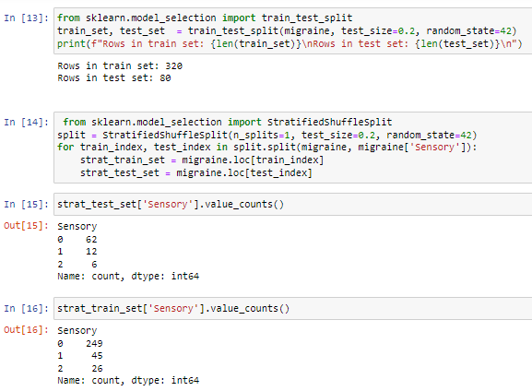
Train – test splitting

Slide 11
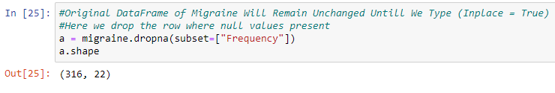

Handling missing attributes
Notes:
For handling the missing attributes we have three approaches
1> delete the null values form the rows
2> delete the whole columns
3> put median in the place of null values

Slide 12
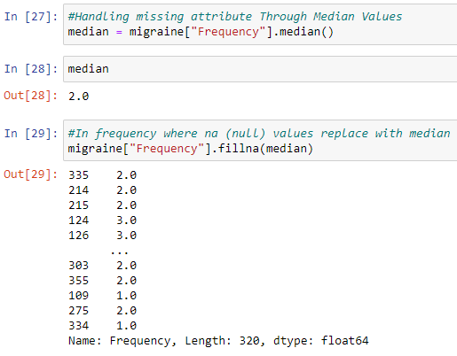
Handling missing attributes

Slide 13

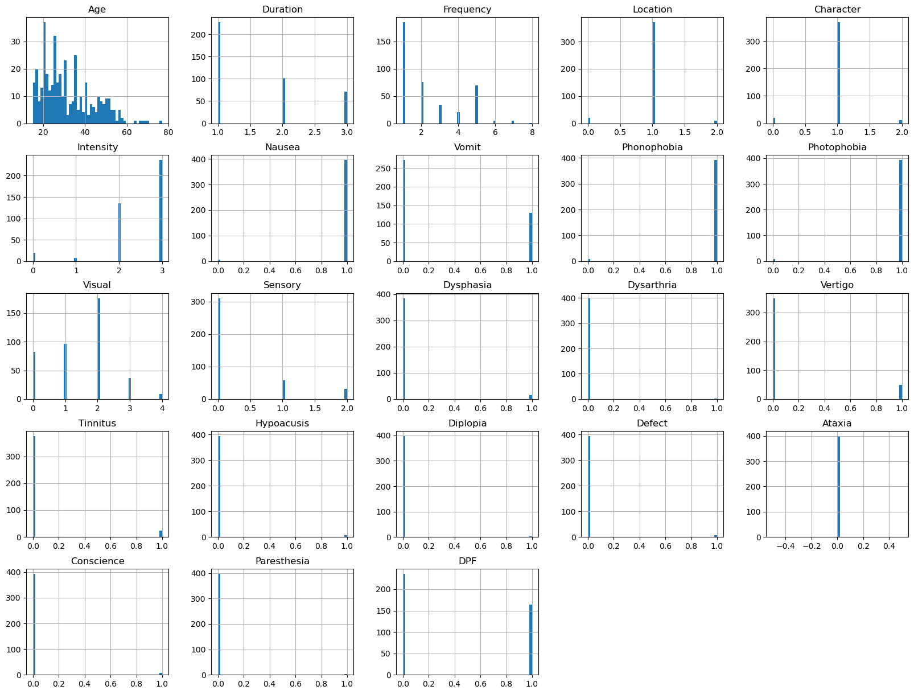
Data Visualization

Slide 14

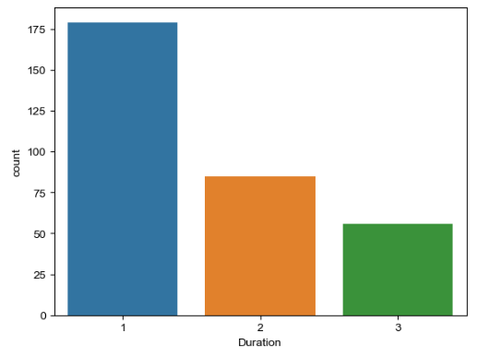
Exploratory Data Analysis (EDA)

Slide 15
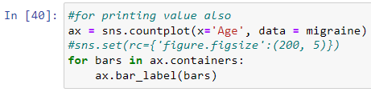
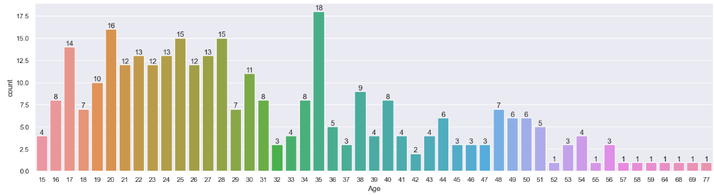
Exploratory Data Analysis (EDA)

Slide 16

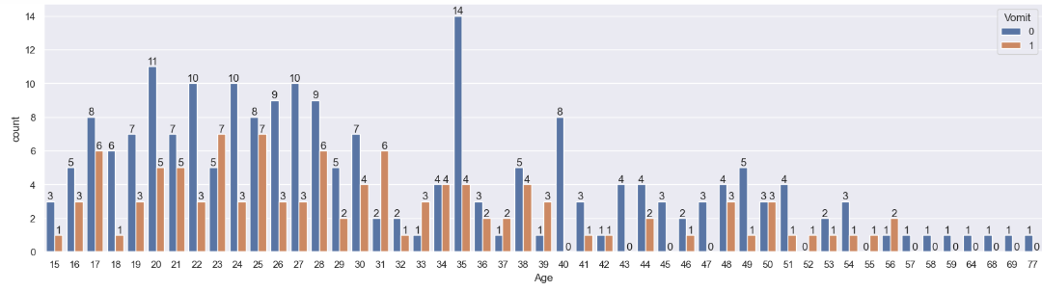
Exploratory Data Analysis (EDA)

Slide 17
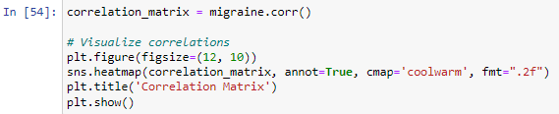
Looking For Correlations
Heatmap using seaborn library
Heatmaps are just a way to visually represent data, making it easier to spot patterns or differences at a glance.
The value 0 usually corresponds to the lowest or minimum value in the dataset and is often represented by a lighter color (such as white or light yellow).
The value 1 typically represents the highest or maximum value and is often represented by a darker color (such as black or dark blue).

Slide 18
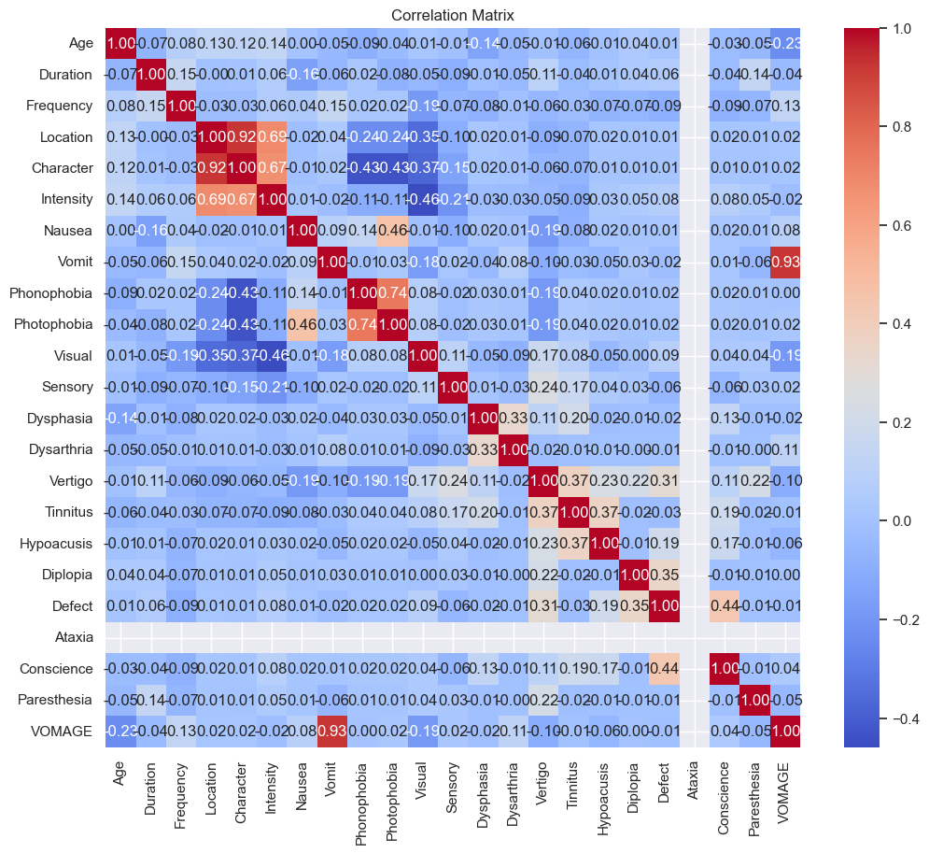
Looking For Correlations

Slide 19
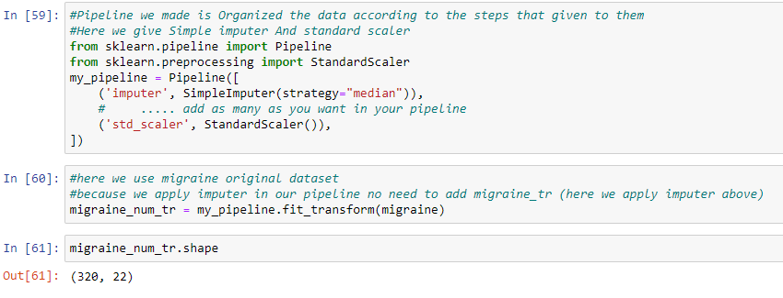
creating a pipeline

Slide 20
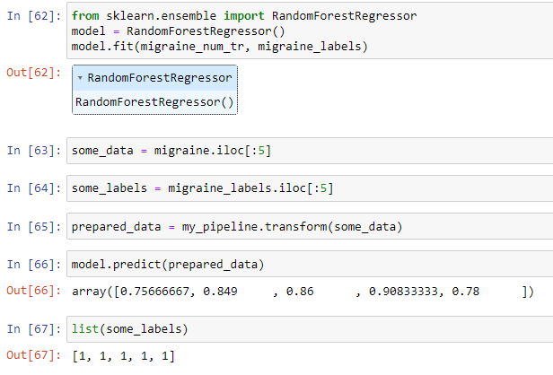
Random Forest Regressor

Slide 21
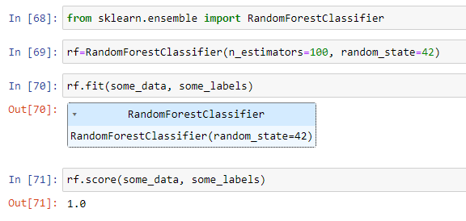
Random Forest Classifier

Slide 22

Thank you

